Slide 1
E-Safety Workshop
A Workshop to support parents with keeping their children safe online
Clee Hill Community Academy

Slide 2
Aims
E-safety in the Computing Curriculum.
Reflect on the potential risks of internet use for children.
Be aware of the importance of communication with children about the time they spend online.
Understand how to find out about setting up parental controls on home and mobile devices.
Know what to do if your child encounters problems online.

Slide 3
E-Safety in the National Curriculum
The Computing Curriculum is divided into 3 strands:
Computer Science
Computer Science is the study of the foundational principles and practices of computation and computational thinking, and their application in the design and development of computer systems.
Information Technology
Information Technology deals with the creative and productive use and application of computer systems, especially in organisations, including considerations of e-safety, privacy, ethics, and intellectual property
Digital Literacy
The ability to read, spell, punctuate, and perform basic arithmetic, are essential life skills, so is the ability to use a computer. Digital Literacy is the ability to use computer systems confidently and effectively, including Basic keyboard and mouse skills. Simple use of ‘office applications’ such as word processing, presentations and spreadsheets. Use of the Internet, including browsing, searching and creating content for the Web, communication and collaboration via e-mail, social networks, collaborative workspace and discussion forums.

Slide 4
OFSTED’s stance on E-Safety
With more pupils than ever gaining access to technology, and at an ever earlier age, the new Ofsted framework for school inspection – introduced in September 2012 and updated in April 2014 – includes specific requirements for schools on e-safety to achieve good or outstanding grading.
What do OFSTED expect of schools?
E-safety is not really about technology – it is about people and their actions. Technology provides new learning opportunities – online collaboration, anytime anywhere learning and communication – but at the same time can provide additional opportunities for students to access material they shouldn’t, or be treated by others inappropriately.
Schools must therefore engage and encourage the contribution of pupils, parents and the wider school community. This requires implementing clear channels of reporting of potential e-safety issues by both students and parents.

Slide 5
E-Safety in the classroom
Within the Digital Literacy strand, pupils will be taught to:
“use technology safely and respectfully, keeping personal information private and identify where to go for help and support when they have concerns about content or contact on the internet or other online technologies”.
At Clee Hill Community Academy, we follow the purple mash scheme of work, which teaches important e-safety messages as separate topics and integrated into computing lessons.
http://chcacademy.co.uk/media/14162/computing-long-term-planning.pdf
The school also take part in safety Internet week, every year, when we share our Acceptable Use Policy with the children, run E-safety assemblies and share information for
Parents, such as this workshop.

Slide 6
Why is it IMPORTANT?

Slide 7
Why is it IMPORTANT?

Slide 8
Why do YOU need to know about E-safety?
IN SCHOOL
Supervised, filtered & monitored
OUT OF SCHOOL
Often no supervision, filtering or monitoring
Know IT All
79% of young people use the internet privately without their parent’s supervision

Slide 9
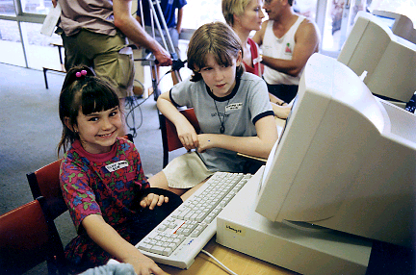
Why do your children need to know about E-safety?
KNOWLEDGE
Many children pick up technology quicker!
WISDOM
Understanding how to behave in a virtual world
Know IT All
69% of young people say they mind their parents restricting or monitoring their internet usage!

Slide 10
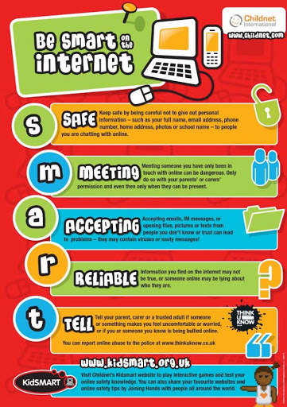
Areas of E-Safety covered in school
SMART rules
Cyber bullying
Pop-ups
Social Media
Viruses, hacking and security
Dangers of Online Gaming

Slide 11
What can parents do to help their child to be safe?
DO NOT STOP YOUR CHILD USING THE INTERNET
Firstly this doesn’t work, but it drives their use underground and they are then not able to talk to you if they get in trouble
Secondly the internet is the greatest ever single invention that has the potential to make the world a better place. It’s already more significant than the inventions of the printing press, radio, telephone and TV put together!

Slide 12
What can you do? COMMERCE
Install software to protect your computer’s security
Be careful which sites the rest of the family visit
Use a family email address for shopping and online forms
Use the free technology: pop-up blockers & SPAM filters; and your good judgement: don’t reply to SPAM!
Check sites for extra security (padlock/https)

Slide 13
What can you do? CONTENT
Talk to your children about what to do if they do come across something unpleasant and teach them to be critical
Use child-friendly search engines or set a search filter
Encourage them to use browser tools – Bookmarks & History
Install filtering but don’t rely on it
Find appropriate sites to visit and try not to overreact – lots of inappropriate content viewed accidentally

Slide 14
What can you do? CONTACT
Get involved with your children online and encourage balanced use – set time limits
Make sure they know who to talk to if they feel uncomfortable
Talk about the consequences of giving out personal info or making information public
Keep the computer in a family room
Agree rules as a family – meeting up

Slide 15
SMART Rules
SAFE – Keep safe by being careful not to give out personal information – including full name and email address - to people who you don’t trust online.
MEETING – Meeting up with someone you have only been in touch with online can be dangerous. Only do so with your parent’s/carer’s permission and even then only when they can be present.
ACCEPTING – Accepting e-mails, IM messages or opening files from people you don’t know can be dangerous – they may contain viruses or nasty messages!
RELIABLE – Someone online may be lying about who they are, and information you find on the internet may not be true. Check information and advice on other websites, in books or ask someone who may know.
TELL – Tell your parent/carer or teacher if someone or something makes you feel uncomfortable or worried, or you or someone you know is being cyberbullied.

Slide 16
What to do if your child sees inappropriate material online
Don’t overreact if your child tells you about something they have seen. You might feel shocked and an­gry but by dealing with it calmly your child will know they can turn to you again.
ALWAYS keep records of abusive messaging.
Report abusive or inappropriate behaviour to the website and if serious, to the police. Keep the school informed too.
If you come across illegal content, such as images of child abuse, you should report this

Slide 17
Where to Report
The UK Hotline for reporting criminal online content
www.iwf.org.uk
www.ceop.police.uk
www.thinkuknow.co.uk

Slide 18
Parental Controls
https://www.nspcc.org.uk/preventing-abuse/keeping-children-safe/online-safety/parental-controls/

Slide 19
Useful Websites
https://www.thinkuknow.co.uk/parents/
http://www.saferinternet.org.uk/advice-and-resources/parents-and-carers
http://www.childnet.com/parents-and-carers
https://www.nspcc.org.uk/preventing-abuse/keeping-children-safe/online-safety/
http://www.kidsmart.org.uk/parents
http://www.netsmartz.org/Parents

Slide 20
Reporting Concerns to School
Please report any E-safety concerns to your child’s classroom teacher or Mrs Little, Headteacher.
Clee Hill community Academy is a telling school. This means that we encourage an ethos where children feel secure, are encouraged to talk and are listened to.

